Slide 1
Maximizing Local Media Resources

Slide 2
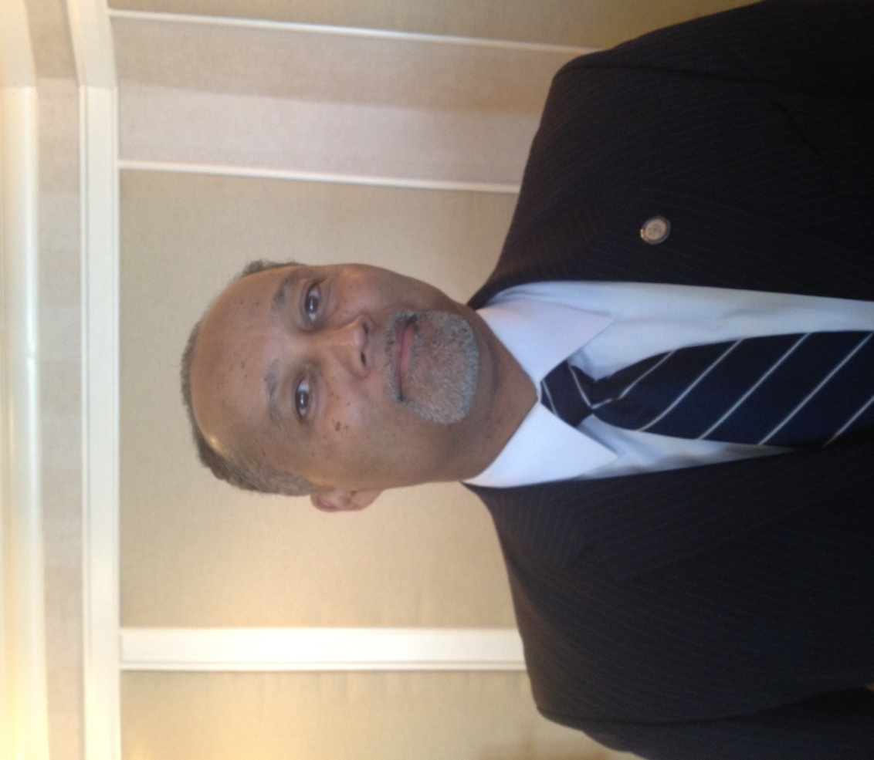
“Use Them Like They are Going to Use You.”
-Mike Garcia
Mike Garcia

Slide 3
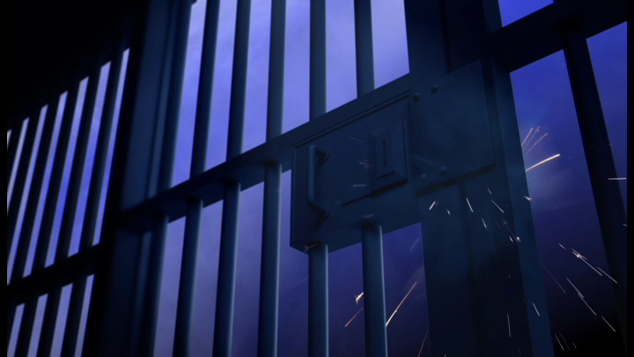
2011 BENCHMARKS
10,000 Arrests
$1,000,000 In Reward Paid
$1,000,000 Property Recovered

Slide 4
Valley Crime Stoppers Board Members Present Today
Detective Brad Stevens, Fresno Police Department
Community Service Officer Milt Vann, Fresno County Sheriffs
Captain James Gentry, Clovis Police Department
Lieutenant Bob Kandarian, Fresno County Sheriffs (MAGEC)
Debbie Rompal

Slide 5
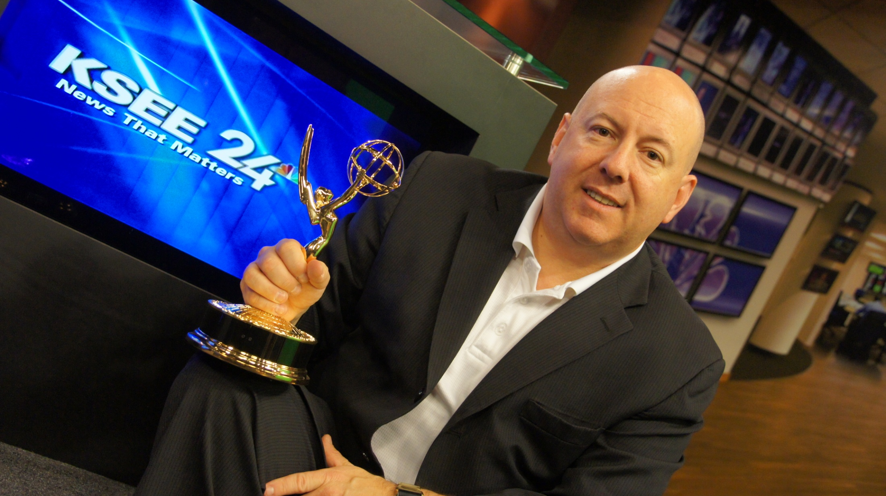
President/General Manager
Matthew Rosenfeld joined KSEE in July 2009; before that he was President/GM for two CBS affils and one CW station in Upstate New York, Syracuse & Binghamton also within Granite Broadcasting.
Matthew Rosenfeld

Slide 6
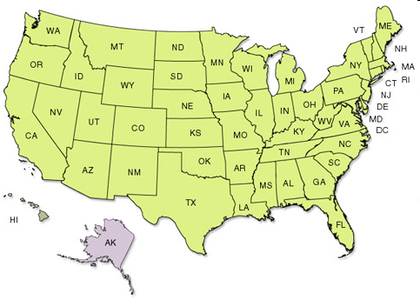






Station Manager
President/GM
President/GM

Slide 7
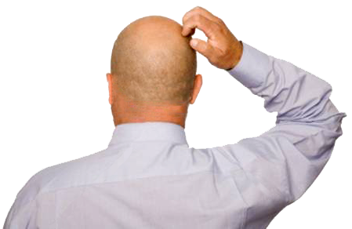
Why Am I Here?

Slide 8


Slide 9

QUESTIONS.
Frustrated by Fundraising?
Frustrated by Media Support?
Do You Work with All TV Stations or Exclusive to One?
Feel like you are not getting traction?

Slide 10
WHY I’M HERE.
I’m here to help.
Or at least give you the Media Perspective

Slide 11
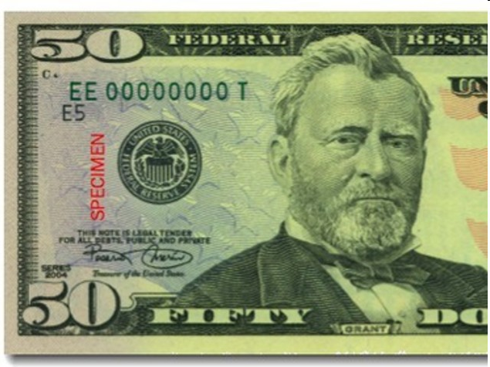
What is
Television?
One Word.
(You could substitute Radio, Newspaper)

Slide 12
Television is a
BUSINESS.

Slide 13
FACTS ABOUT LOCAL MEDIA
We are bombarded with requests everyday
We have no obligation to cover, sponsor every event, we already do A LOT for our communities
We reach massive amounts of people, thus BROADcasting, and we don’t need to reach the people at your event
We have less people than we did 5 years ago but We want to help if we can
We want to be hyperlocal
Probably someone at the station wants to help you
But there has to be at better BUSINESS REASON for it

Slide 14
CONNECTED TO THE COMMUNITY
More Than Any Other Central Valley Television Station
Valley Crime Stoppers
American Red Cross
March of Dimes
Salvation Army
American Heart Association
Susan G. Komen Race for the Cure
The Pink Show
Make A Wish Foundation
Fresno PBID (Property Based Improvement District)
Taste of Armenia
Rotary Storyland & Playland
Center for Advanced Research & Technology (CART)
The Big Fresno Fair
Make a Difference Day/City of Fresno
Granville Home of Home
Boys & Girls Club
Fresno Performing Arts Council
Central Valley Business Incubator
Catholic Charities
Two Cities Marathon
Buddy Check Breast Cancer Awareness
Philanthropy Inspired by the Needs of our Community (PINC)
First 5 Fresno County
And Countless More…

Slide 15
WHAT IS IMPORTANT TO MEDIA
Revenue
Ratings/Viewership/Readership
Content
User Generated Content
Web Traffic, Social Media
Exclusivity
Ease (Less positions)
Revenue

Slide 16




How Many Media Outlets
Do Need to Work With?
RADIO Stations
TELEVISION Stations

Slide 17

TWO MODELS

Slide 18
TWO MODELS
Work with All the Television Stations in the Market
Have an Exclusive Arrangement with One TV Station, One Radio Group, One Newspaper

Slide 19

EXCLUSIVITY

Slide 20





Exclusive Media Sponsors

Slide 21
TELEVISION PARTNER
Produce & Air Weekly Re-enactments (example)
Air Image & Call to Action Spots (example)
Most Wanted (M,W,F) (example)
Arrest of the Day (M,W,F) (example)
All Crime Stories Direct to Crime Stoppers (example)
Pipeline to Newsroom
Cover Press Conferences
Produce & Air Fundraising Promos (example)

Slide 22
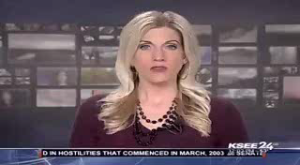
CRIME STORIES >>CS BRAND

Slide 23

TV REENACTMENTS

Slide 24

TV DOUBLE REWARDS

Slide 25

TV SEXUAL PREDATORS

Slide 26

TV INSURANCE FRAUD

Slide 27

TV FUNDRAISING PROMOS

Slide 28
SUCCESSFUL CAMPAIGNS
Domestic Violence
Ag Crimes
Gun Buyback
Meth to Death
Bust the Harvest

Slide 29
WHY EXCLUSIVITY WORKS
One Media Outlet’s Commitment, More Than You’ll Ever Get With Sharing Between Them All
One TV Station Reaches 60% of Fresno Market Viewers, 1.3 Million in 1-2 weeks, 95% Over Time
CS Gets Commitment, Branding, Board Members
Media Receives
Some Exclusive Information/Content from Law Enforcement
Recognition
Connection to Doing Good in Community
Sponsorship Opps to Sell

Slide 30

NEED A PLAN, PITCH
“Do your homework. Don’t waste their time.
Always about ROI.”
-Dan Stark
Jammed packed w ROI, Elevator Pitch Not Good Enough

Slide 31
TELEVISION PARTNER
Produce & Air Weekly Re-enactments (example)
Air Image & Call to Action Spots (example)
Most Wanted (M,W,F) (example)
Arrest of the Day (M,W,F) (example)
All Crime Stories Direct to Crime Stoppers (example)
Pipeline to Newsroom
Cover Press Conferences
Produce & Air Fundraising Promos (example)

Slide 32
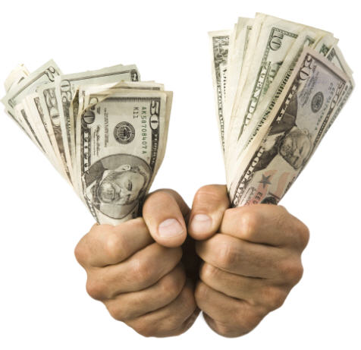
THE PAYOUT, PRIZE, GOAL
$200,000
ANNUAL VALUE IN AIRTIME, PRODUCTION
Tips
Arrests
Branding

Slide 33
THE OTHER MODEL

Slide 34

WHO CAN GIVE YOU (FREE) EXPOSURE?

Slide 35
THE CENTRAL VALLEY HAS ONE OF THE LOWEST CABLE PENETRATION IN THE UNITED STATES
Fresno Ranks 204 of 212 Cities in terms of Wired Cable Subscription*
Cable is not in
62%
Of All Central Valley Homes.
That’s
349,525
Missed Homes!
Source: 2010 Marshall Marketing & Research
*Source: TVB.org Cable & ADS Penetration List

Slide 36
WHOSE CAN GIVE YOU FREE EXPOSURE?
NEWS
News Director
Producers
Anchors
Reporters
Photographers
SALES
Gen Sales Mgr
Local Sales Mgr
Account Execs
PROMOTIONS
PROGRAMMING
Promotions Mgr
Marketing Mgr
Program Director
Community Liason

Slide 37
WHO CAN GIVE YOU (FREE) EXPOSURE?
PROMOTIONS
PROGRAMMING
Promotions Mgr
Marketing Mgr
Generally These People Care About
Signage, logos, brand
Interacting w your attendees
Handouts
Booth Space
Not giving you a lot of inventory, resources
Increasing Viewership

Slide 38
WHO CAN GIVE YOU (FREE) EXPOSURE?
NEWS
News Director
Producers
Anchors
Reporters
Photographers
Generally These People Care About
Want the info, but often end up with People Angle Stories
Numbers, Stats
Getting In and Out Fast
Convenience
Exclusivity
Increasing Viewership

Slide 39
PERFECTING THE PRESS RELEASE
Who uses press releases? You should.
Who has had success with releases?
Weekends are slow news days, less staff.
Mondays are typically slow news days
Send it to everyone. Blind.
Attach the release PLUS copy content into email.
Include all the information, but what is your angle?
Follow Up with a Phone Call(s)

Slide 40
PERFECTING THE PRESS RELEASE
Send Multiple Times. Like 3.
Create relationships. Early.
Who are the players?
Customize.
Recruit Station Personnel to be on Committee, Board
Most newsrooms have morning and afternoon editorial meetings

Slide 41

Not exactly true.

Slide 42
LOCAL NEWS FEATURES
Which of the following features are important to you in local news coverage?

Slide 43
WHOSE CAN GIVE YOU FREE EXPOSURE?
SALES
Gen Sales Mgr
Local Sales Mgr
Account Execs
These People Care About
Revenue
Finding Sponsors =Revenue
Web Traffic=Revenue
Making their Current Advertisers Happy= Revenue
Finding New Advertisers =Revenue

Slide 44
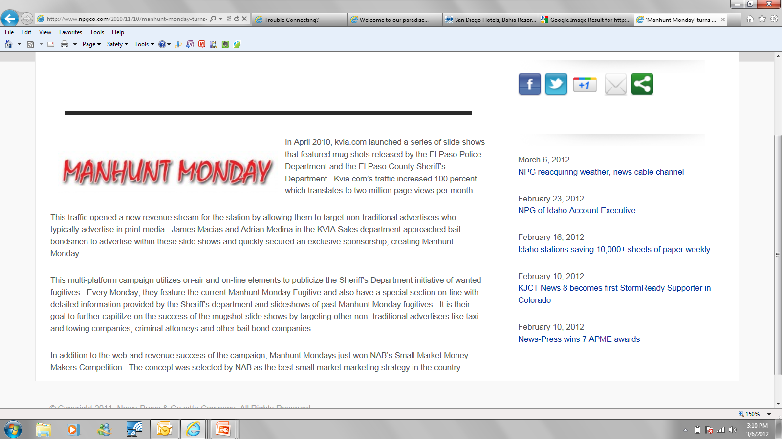
SELECTED BY NAB AS THE BEST
SALES/MARKETING IDEA IN THE COUNTRY

Slide 45
Broadcasting is a
BUSINESS.

Slide 46
Consider Exclusivity.
Partial Exclusivity.
Remember Media Perspective.
Fundraising is Key.
Create Airtight Proposal.
Be Proactive. Aggressive.

Slide 47
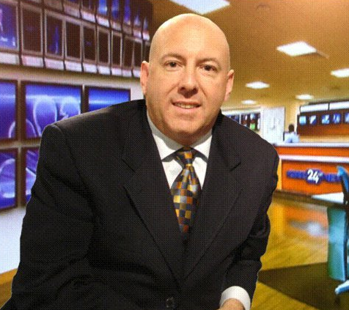
Matthew A. Rosenfeld President/General Manager KSEE-NBC24 Fresno, CA KSEE WeatherPlus Fresno, CA LATV la alternativo Fresno, CA
m. 559.304.1764
e. mrosenfeld@ksee.com
Matthew Rosenfeld

Slide 49
Thank You.

Slide 50
POSSIBILITIES
News Coverage
In-Studio Interviews
LIVE Broadcasts, LIVE Reports & Weather
Schedule of Promotional Spots
Don’t say PSAs anymore
Promotional Web Campaign
LIVE Preview Show of Your Event
Contests & Promotions

